Slide 1
CUSTOMER BETA PROGRAM Denodo OData Service
30 July 2015
CONFIDENTIAL

Slide 2
The BETA Program

Slide 3
Project Status
Unpublished (first BETA)
Developed by DenodoLabs
To be distributed through a specific channel during BETA
Future DenodoConnect Enterprise component
Distributed from the Support Site

Slide 4
BETA Program: Timeline
GA intended publishing date: 2 September 2015
Feedback channel: email
Not the Support Site (unpublished software!)
Daniel Fernández dfernandez@denodo.com

Slide 5
The Denodo OData Service

Slide 6
Artifact Overview
A Java Web Application (.war)
Deployed on e.g. an Apache Tomcat server
Additional northbound interface for Denodo Platform
Multi-database – serves an entire Denodo installation
Southbound: connects to VDP via JDBC

Slide 7
OData support
Supports OData 2.0 (partially)
http://www.odata.org/documentation/odata-version-2-0/overview/
http://www.odata.org/documentation/odata-version-2-0/uri-conventions/
OData 4.0 is an OASIS standard since 2014
Why 2.0?
OData 4 clients can talk to OData 2 servers
SalesForce LightningConnect
Technical constraint: unstable dependencies

Slide 8
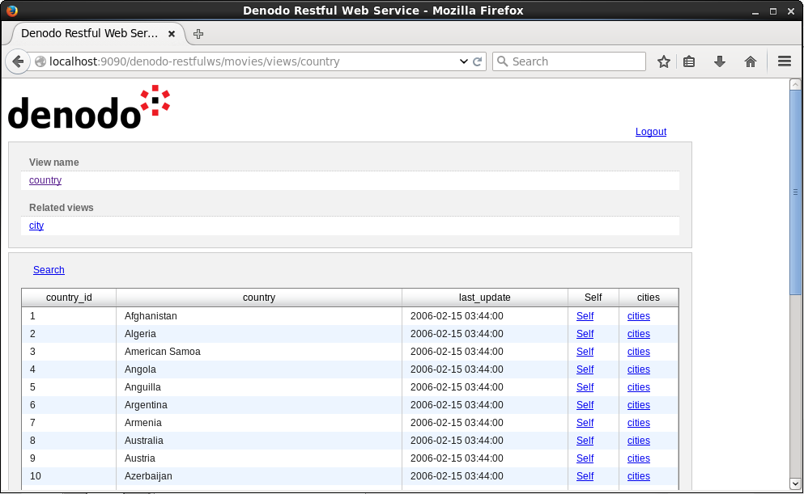
ODataServ vs RESTfulWS
Similar in concept to the RESTfulWS
http://localhost:9090/denodo-restfulws
Authentication, URLs…
But no HTML interface!

Slide 9
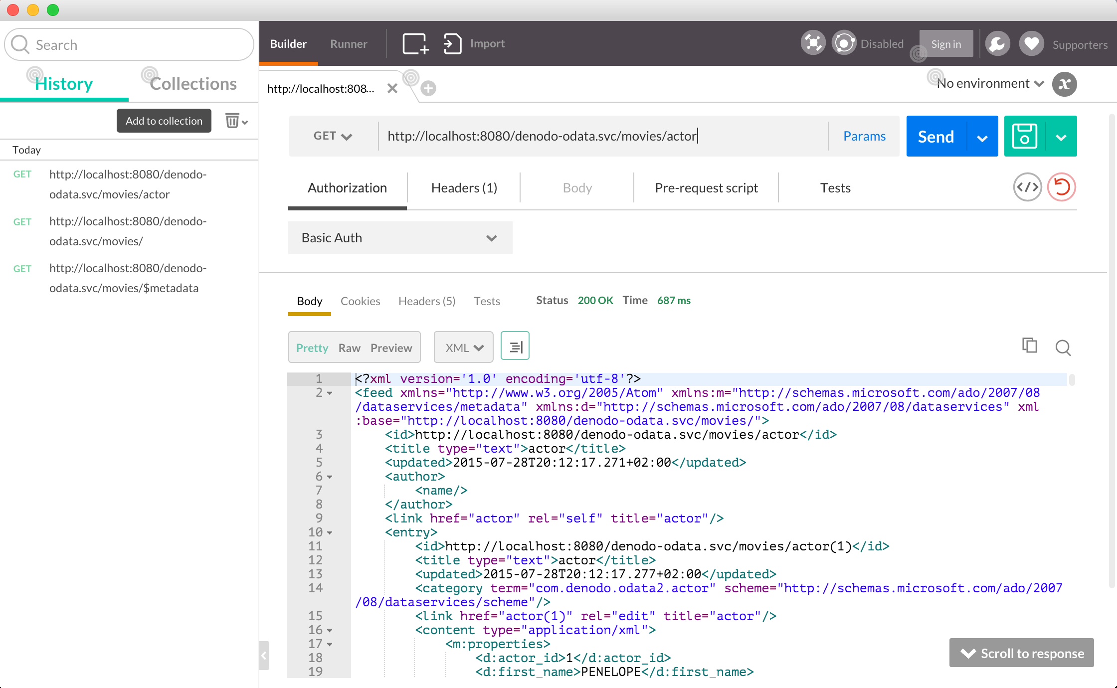
Recommended Tools
API Tools: Postman, HTTPRequester…

Slide 10
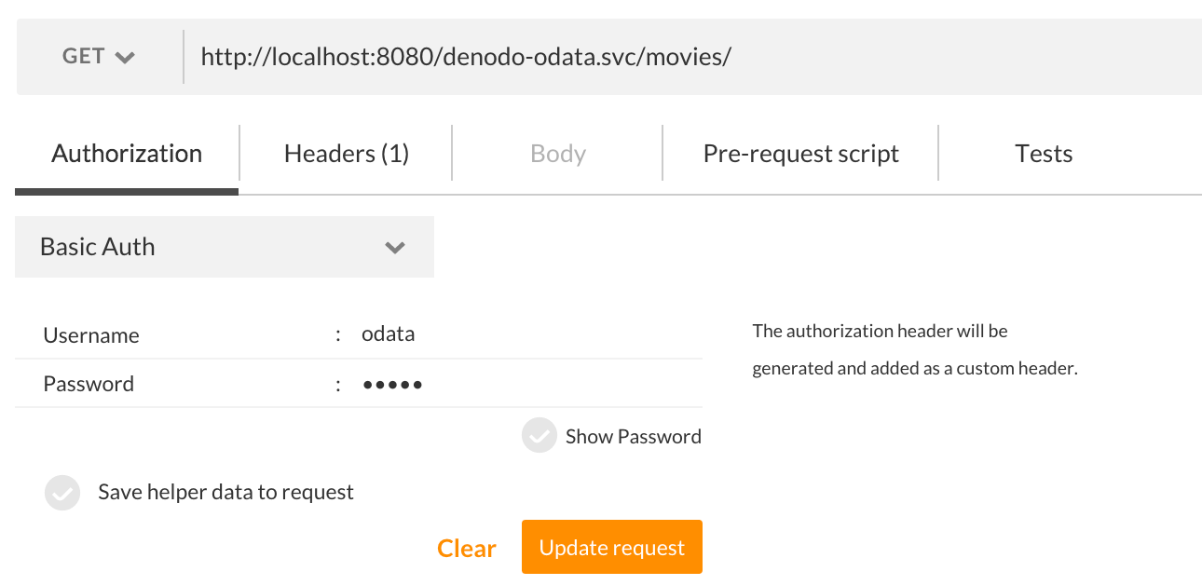
Authentication
RESTfulWS-like URLs
http[s]://{server}:{port}/denodo-odata.svc/{database}
https://localhost:8080/denodo-odata.svc/movies
RESTfulWS-like authentication

Slide 11
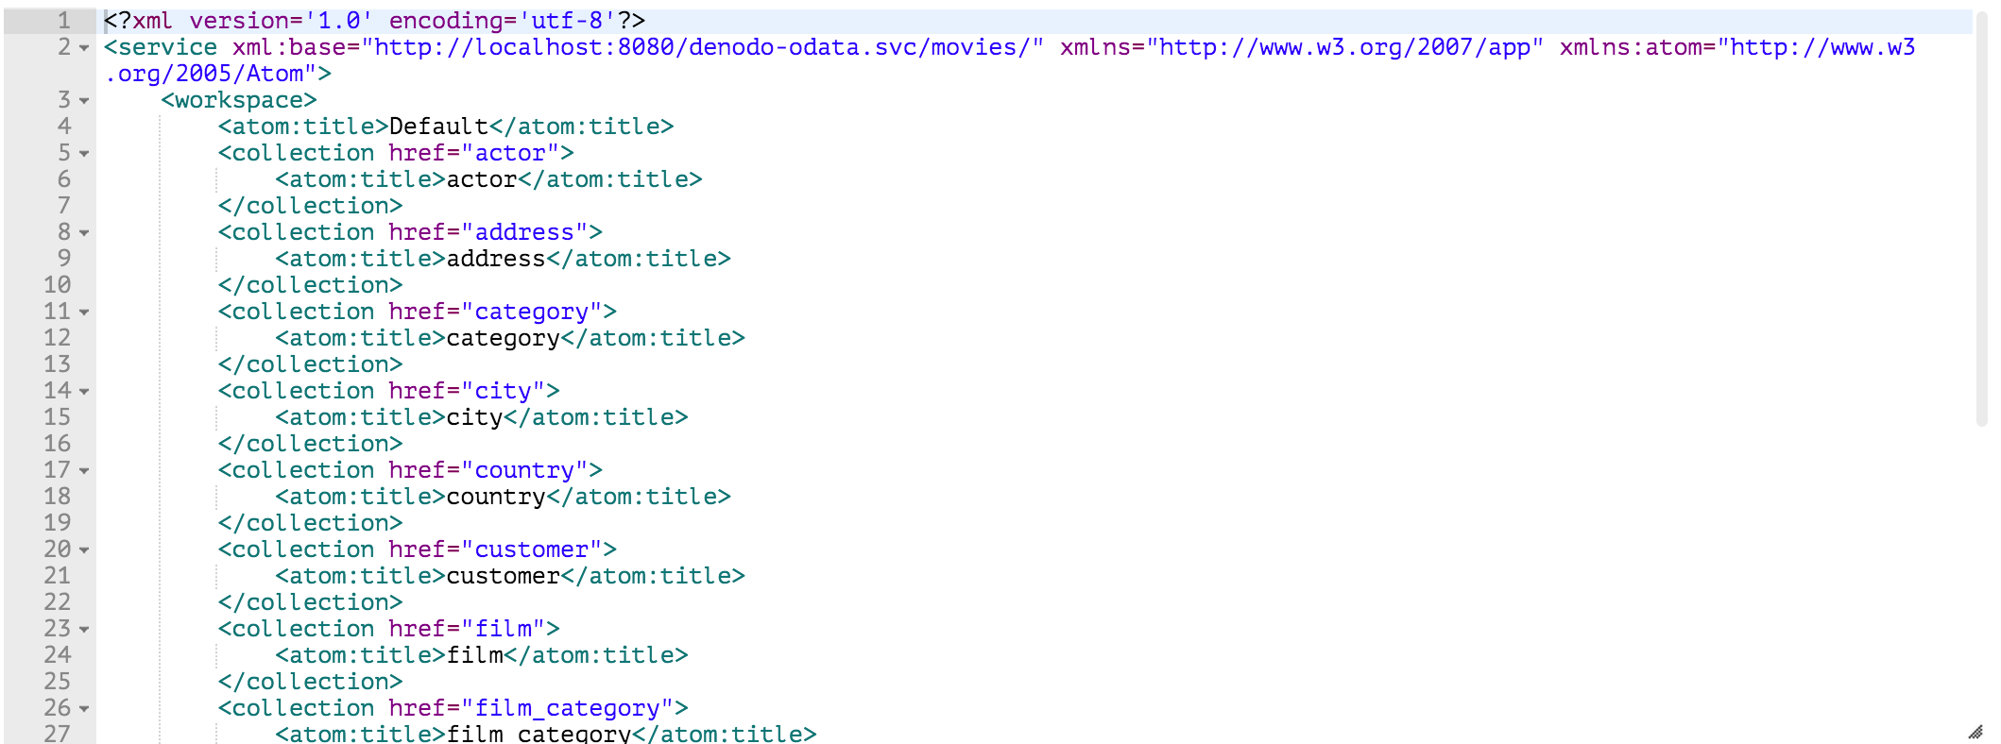
Metadata: Service Document /
OData Service root for each database
Lists the top-level feeds – i.e. the available views

Slide 12
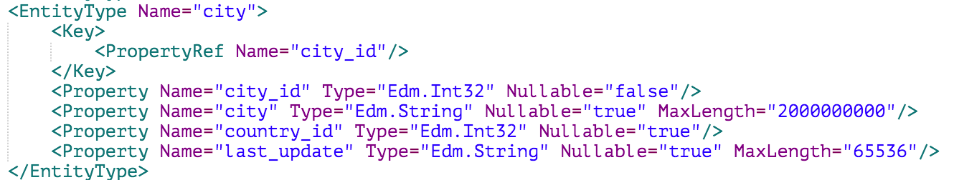
Metadata: Entity Data Model /$metadata
Describes the entire database using CSDL (XML)
5 kinds of artifact:
Entity Types
Associations
Entity Sets
Association Sets
Imported Functions

Slide 13
Mapping OData with VDP
Denodo ODATA Service | VDP
Entity Type | View Definition
Entity Type > Property | View Column
Entity Type > Navigation Property | Association Role
Association | Association Definition
Entity Set | View Data
Association Set | (Associated data)
Imported Functions | -

Slide 14
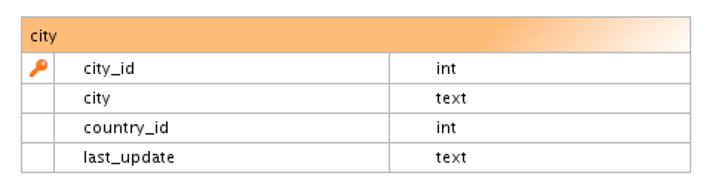
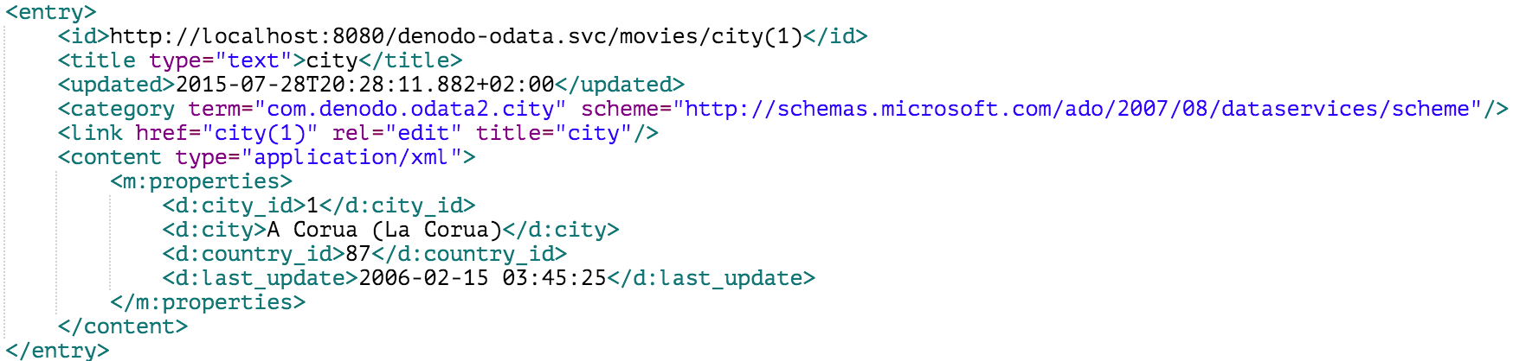
One view, one collection (entity set)
Each view in the VDP database –> collection
http://localhost:8080/denodo-odata.svc/movies/city

Slide 15
ATOMPub vs JSON: $format
Data can be returned in AtomPub (XML) or JSON
Except the EDM (/$metadata) – CSDL is XML
Request parameter:
http://server/denodo-odata.svc/movies/city?$format=json
HTTP Header:
Accept: application/json

Slide 16
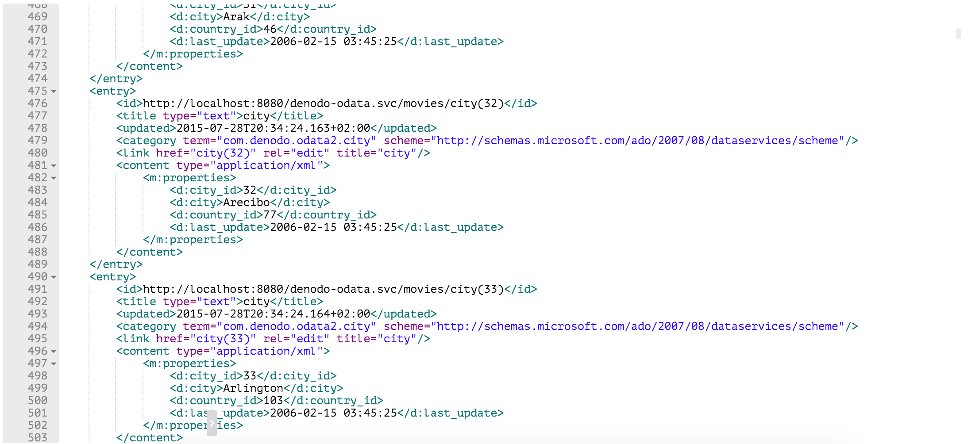
$format=atom (default)

Slide 17
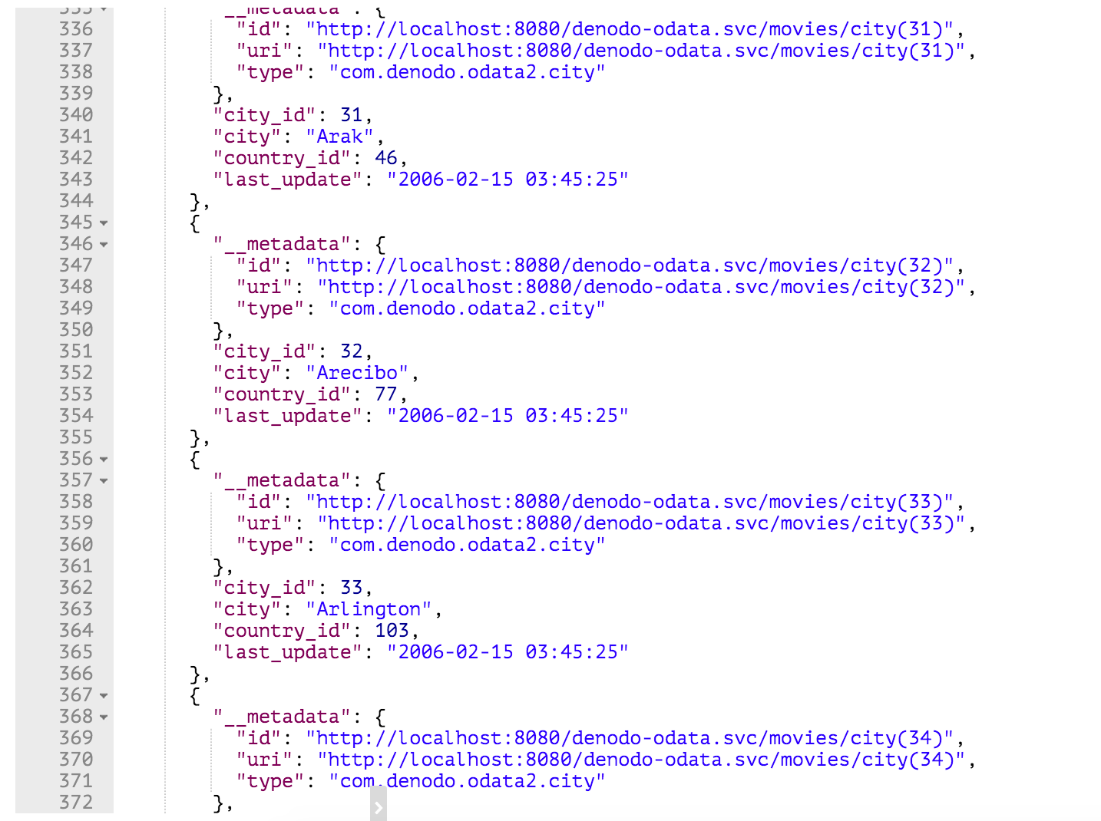
$format=json

Slide 18
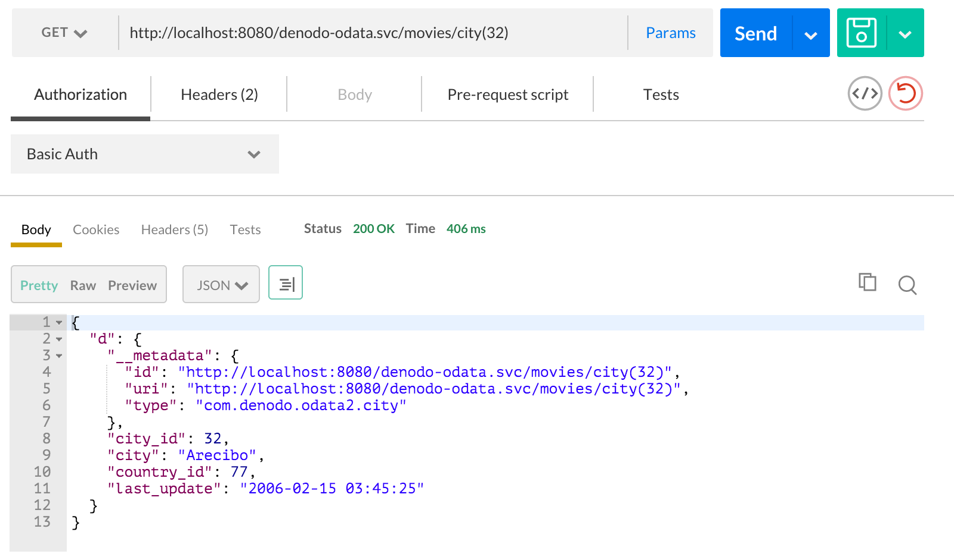
Querying by primary key: (id)
A specific ID can be specified between params:
/denodo-odata.svc/movies/city(32)

Slide 19
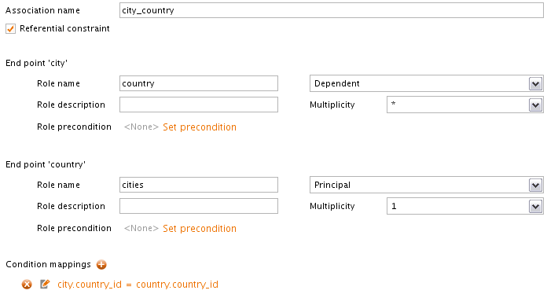
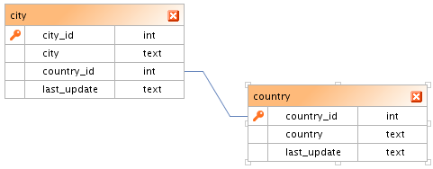
Associations
Associations are defined as logical entities in VDP

Slide 20
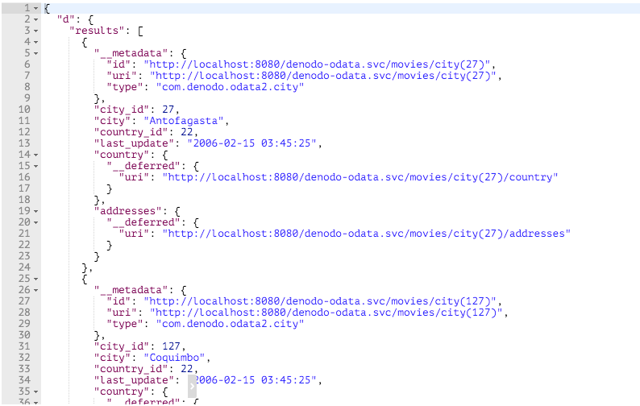
Navigating associations: /navprop
Equivalent to RESTfulWS navigations
Equivalent to SELECT_NAVIGATIONAL queries in VQL
/denodo-odata.svc/movies/country(22)/cities

Slide 21
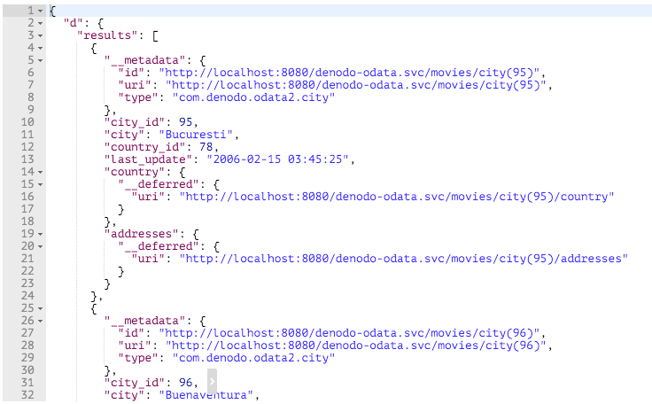
Selection: $filter
Request parameter, WHERE clause in SELECT statement
/denodo-odata.svc/movies/city?$filter=startswith(city,'Bu') eq true

Slide 22
Selection operators: eq, ne, gt, ge…
Currently implemented
eq | gt | lt
ne | ge | le
and | or | not

Slide 23
Selection functions
Currently implemented
startswith() | substringof() | indexof()

Slide 24
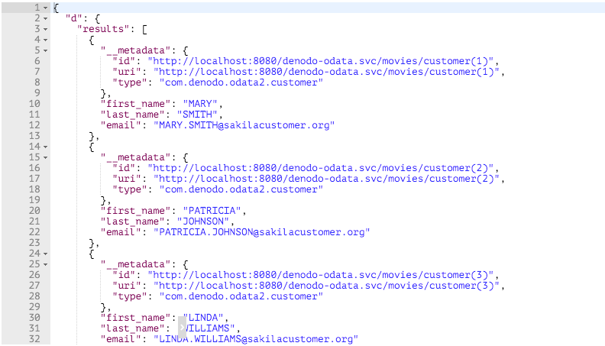
Projection: $select
Selection of specific fields
/denodo-odata.svc/movies/customer?$select=first_name,last_name,email

Slide 25
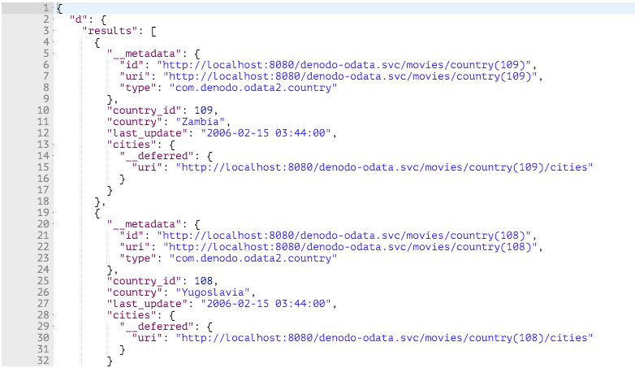
Ordering: $orderby
Order by specific properties...
/denodo-odata.svc/movies/country?$orderby=country desc

Slide 26
Pagination: $top, $skip, $skiptoken
Request-defined pagination:
/denodo-odata.svc/movies/customer?$skip=5&$top=3
Server response includes $skiptoken
Max page size: 1000 results

Slide 27
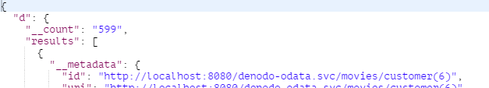
Pagination: $inlinecount
Returns total results
/denodo-odata.svc/movies/customer?$skip=5&$top=3&$inlinecount=allpages

Slide 28
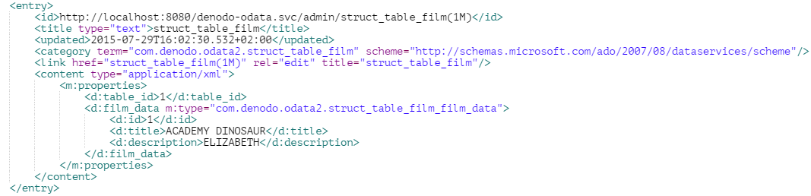
Complex types: structs
Structs are correctly handled by the OData Service

Slide 29
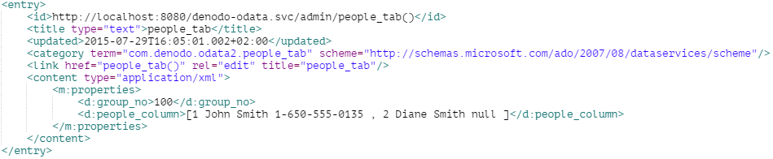
Complex types: arrays
OData 2.0 does not support arrays, default to String rep

Slide 30
Main Limitations
Read-only
Limited sets of operators and functions
No support for the $expand command
Complex types:
No array types in OData 2.0 ☹
Navigation of associations with complex endpoints

Slide 31
The ToolKit

Slide 32
Denodo OData Service ToolKit
Contents
Denodo OData Service distribution (beta):
Denodo OData Service software (beta)
Denodo OData Service user manual
This slide deck
Available after this meeting

Slide 33
Q&A
Notes:
Anybody has any question?

Slide 34
Thank you!

